Slide 1
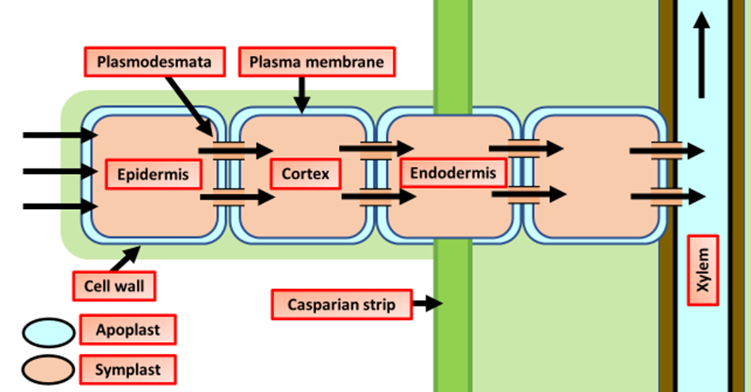

Apoplast Pathway Question
The diagram below shows how water enters the plant. Describe how water moves through a plant via the apoplast pathway.
____________________________________________________________________________________________________________________________________________________________________________________________________________________________________________________________________________________________________________________________________________________________________________________________________________________________________________________________________________________________________________________________________________________________________________________
Answer
Video link

