Slide 1
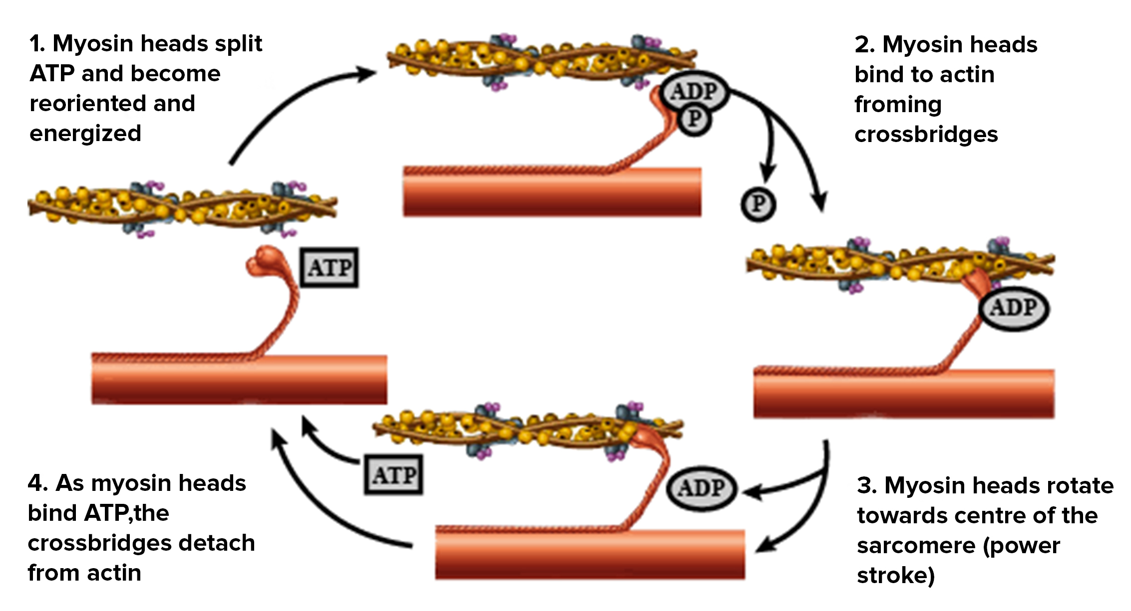
Glucose & Muscles Practice Question
The diagram below shows muscle protein
Explain why glucose is required for the contraction of skeletal muscle.
____________________________________________________________________________________________________________________________________________________________________________________________________________________________________________________________________________________________________________________________________________________________________________________________________________________________________________________________________________________________________________________________________________________________________________________
Answer
Link to video

