Slide 1
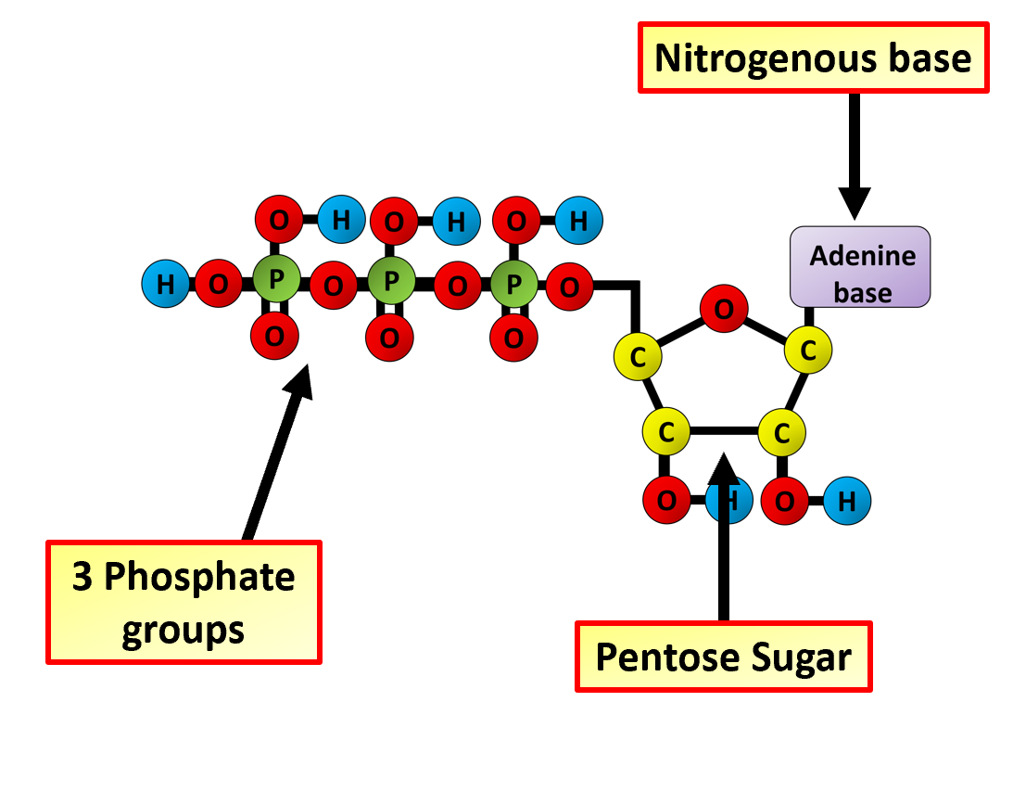
The Great Biology Pubish Quiz
ATP

Slide 2
The Great Biology Pubish Quiz
ATP
What does ATP stand for?
A
Adenine Triphosphate
Adenosine Triphosphate
B
C
Adenine Tetraphosphate
D
Adenosine Tetraphosphate

Slide 3
The Great Biology Pubish Quiz
ATP
What is the primary role of ATP in cells?
A
Storing genetic information
Acting as a structural component
B
C
Providing energy for cellular processes
D
Transporting oxygen

Slide 4
The Great Biology Pubish Quiz
ATP
Which molecule is released when ATP is broken down?
A
Water
Carbon dioxide
B
C
ADP (Adenosine Diphosphate)
D
Glucose

Slide 5
The Great Biology Pubish Quiz
ATP
In which part of the cell is most ATP produced?
A
Nucleus
Ribosomes
B
C
Mitochondria
D
Cytoplasm

Slide 6
The Great Biology Pubish Quiz
ATP
What type of reaction is ATP synthesis?
A
Hydrolysis
Condensation
B
Oxidation
C
D
Combustion

Slide 7
The Great Biology Pubish Quiz
ATP
Which enzyme is responsible for ATP synthesis during cellular respiration?
A
Amylase
B
DNA polymerase
C
ATP synthase
D
Protease

Slide 8
The Great Biology Pubish Quiz
ATP
Question 1
B
Question 2
C
Question 3
C
Question 4
C
Question 5
B
Question 6
C

