Slide 1
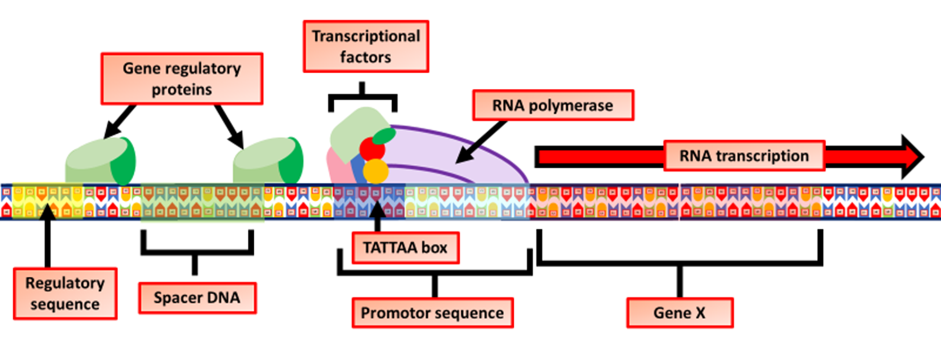
Transcriptional Control Question
The diagram below shows how gene transcription is controlled. Describe how transcriptional control regulates gene expression.
_________________________________________________________________________________________________________________________________________________________________________________________________________________________________________________________________________________________________________________________________________________________________________________________________________________________________________________________________________________________________________________________________________________________________________________________________________________________________________________________________________________________________________________________________
Answer
Video link

