Slide 1
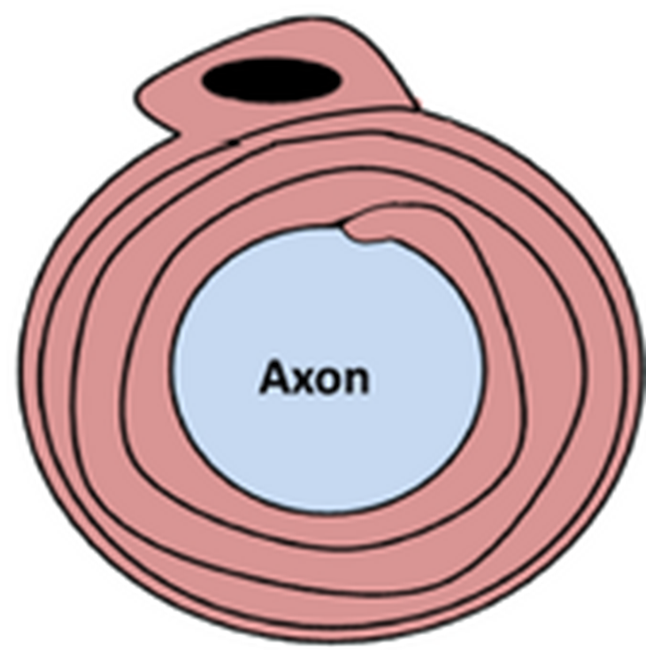
Myelinated Neurones Question
Explain how the structure of a myelinated neurone allows for faster transmission of nerve impulses.
____________________________________________________________________________________________________________________________________________________________________________________________________________________________________________________________________________________________________________________________________________________________________________________________________________________________________________________________________________________________________________________________________________________________________________________
Answer
Video link

