Slide 1
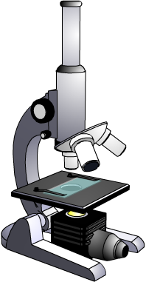
Microscopes Practice Question
The picture below shows a light microscope. Explain in detail how you would look at a cell under the microscope using the highest magnification You must refer to the main parts of a light microscope in your answer.
Key things to include:
Where do you put the slide
What magnification do you use first
How can we focus the microscope
______________________________________________________________________________________________________________________________________________________________________________________________________________________________________________________________________________________________________________________________________________________________________________________________________________________________________________________________________________________
Answer
Link to video

