Slide 1
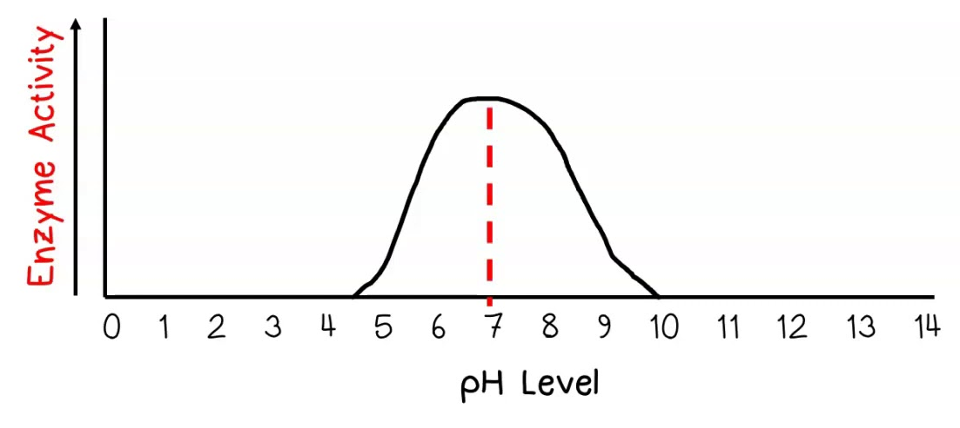

The Effect of pH on Enzyme Activity Question
A student investigated the effect of pH on the rate of an enzyme-controlled reaction. The results are shown in the graph below, where the rate of reaction increases, reaches a peak at pH 7, and then decreases.
Using your knowledge of enzyme action, analyse the data and explain the trend observed.
____________________________________________________________________________________________________________________________________________________________________________________________________________________________________________________________________________________________________________________________________________________________________________________________________________________________________________________________________________________________________________________________________________________________________________________
Answer
Link to video

