Slide 1
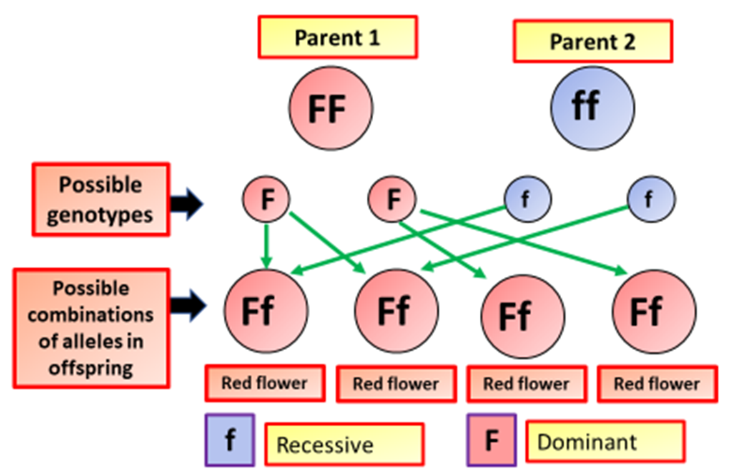

Genetic Inheritance Question
The diagram below shows how genes are inherited
Video Link
What is genetic inheritance?
Where are genes found?
What is the difference between dominant and recessive alleles?
What do we call different forms of the same gene?

