Slide 1
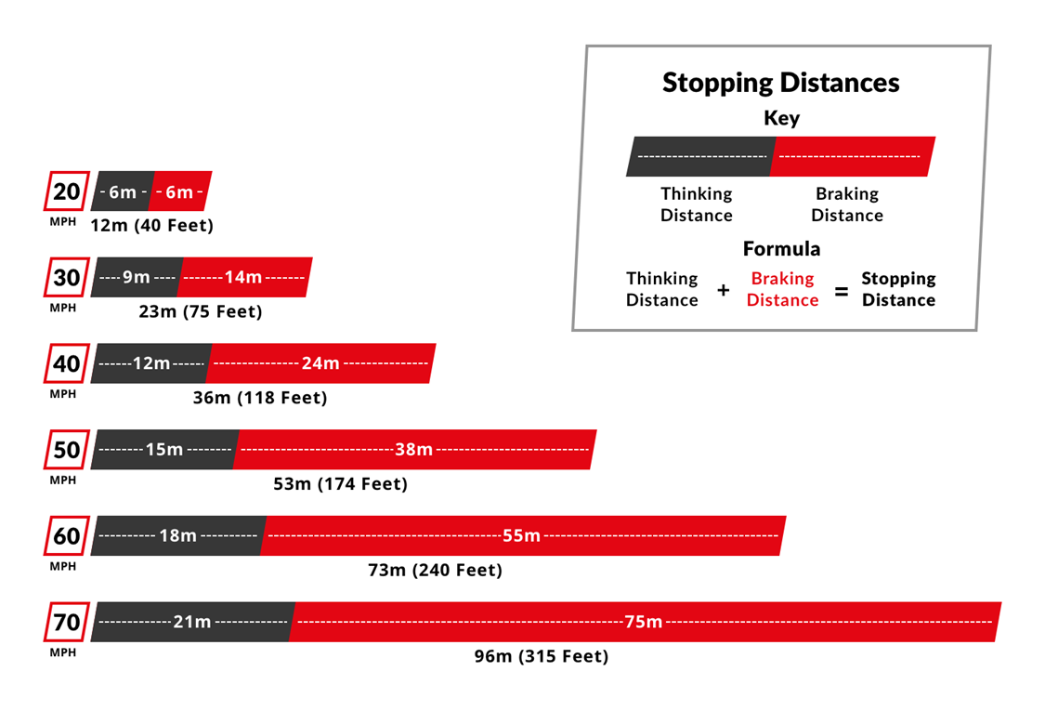

Breaking Distance Practice Question
In an emergency the driver needs to apply the brakes suddenly to stop the car quickly. The driver of the car is distracted.
Mark Scheme
What two factors make up the stopping distance of a vehicle?
What is thinking distance?
Name one factor that increases braking distance.
How does speed affect stopping distance?

