Slide 1
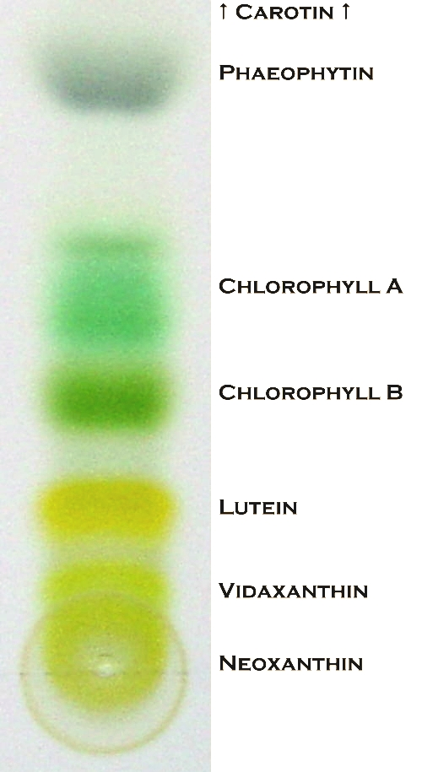

Chlorophyll Chromatography Question
Describe how chromatography can be used to separate and identify chlorophyll pigments from plant leaves.
____________________________________________________________________________________________________________________________________________________________________________________________________________________________________________________________________________________________________________________________________________________________________________________________________________________________________________________________________________________________________________________________________________________________________________________
Answer
Video link

