Slide 1
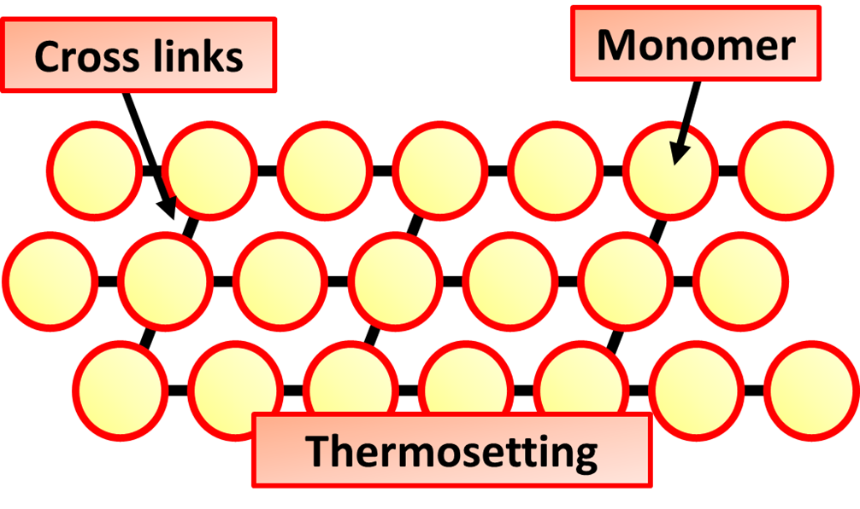
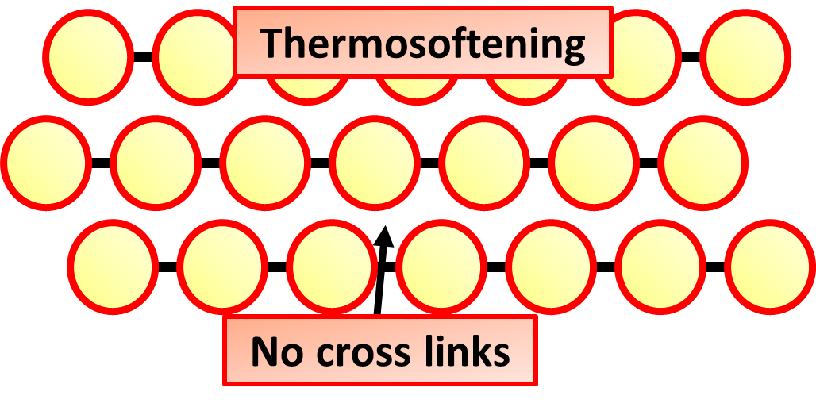
Polymers Practice Question
Polymers are produced from crude oil.
Describe the structure and bonding in a thermosoftening polymer and explain why thermosoftening polymers melt when heated.
Key things to include:
How large are the molecules
The strength of intermolecular bonds
Why they melt easily
Answer
_____________________________________________________________________________________________________________________________________________________________________________________________________________________________________________________________________________________________________________________________________
Link to video

Slide 2
Polymers Practice Question

