Slide 1
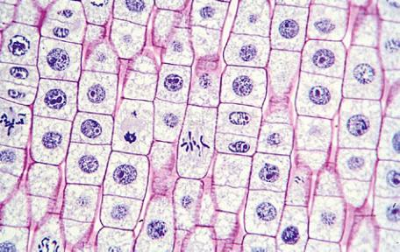
Looking at Mitosis Question
Describe how you would prepare and observe a root tip squash to view cells undergoing mitosis.
____________________________________________________________________________________________________________________________________________________________________________________________________________________________________________________________________________________________________________________________________________________________________________________________________________________________________________________________________________________________________________________________________________________________________________________
Answer
Video link

