Slide 1
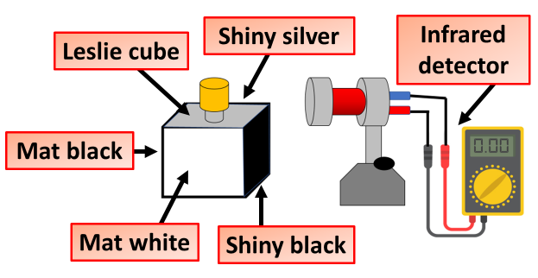

Infrared Practical Practice Question
Heat is transferred by infrared radiation
Describe an investigate how the amount of infrared radiation absorbed or radiated by a surface depends on the nature of that surface
Key things to include:
Dependent variables
Independent variables
Control variables
_______________________________________________________________________________________________________________________________________________________________________________________________________________________________________________________________________________________________________________________________________________________________________________________________________________________________________
Answer
Link to video

Slide 2
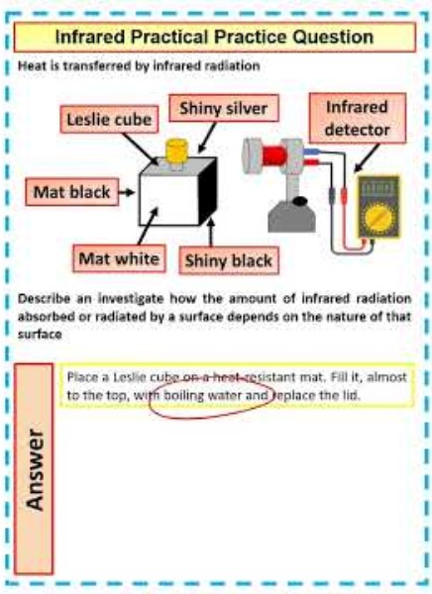
Infrared Practical Practice Question

