Slide 1
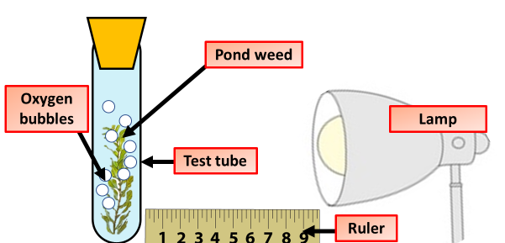
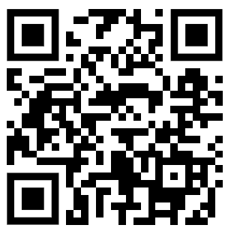
Measuring Photosynthesis Question
Describe how you could measure the rate of photosynthesis in a pondweed experiment.
Key things to include:
The independent variable
The dependent variable
The control variables
_______________________________________________________________________________________________________________________________________________________________________________________________________________________________________________________________________________________________________________________________________________________________________________________________________________________________________
Answer
Link to video

