Slide 1
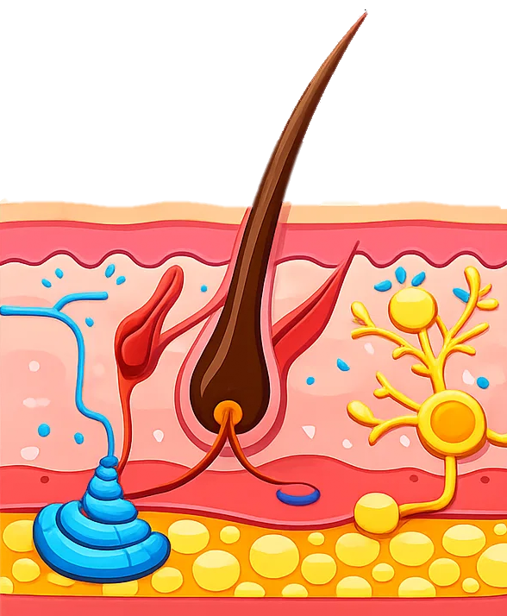



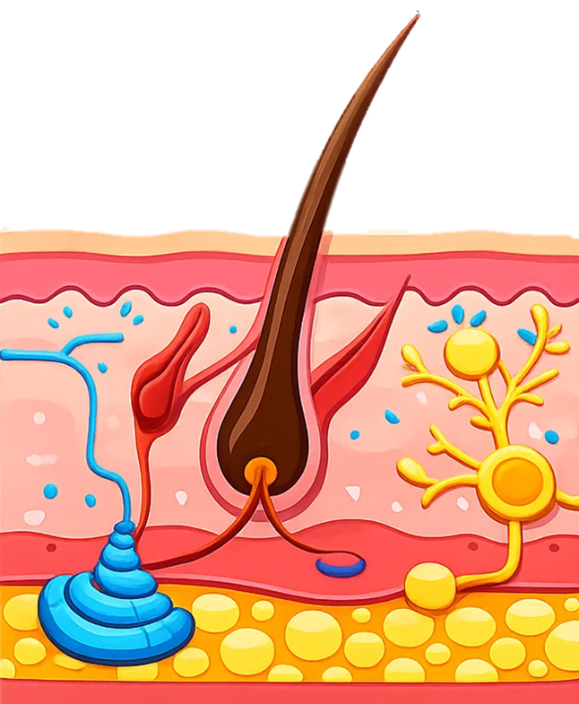
The Role of the Skin
1: The Skin helps regulate body temperature by controlling heat loss from the body
Key questions
2: When the body is too hot, sweat glands in the skin produce sweat.
How does the Skin help control body temperature?
6: These changes help maintain a stable internal temperature of about 37 °C.
What do sweat glands produce when the body is too hot?
3: Sweat evaporates from the surface of the skin, removing heat and cooling the body
How does sweating help cool the body?
What is the name for the widening of blood vessels near the skin?
5: When the body is too cold, blood vessels narrow in a process called Vasoconstriction, reducing heat loss.
4: Blood vessels near the skin widen in a process called Vasodilation, allowing more heat to escape.
What is the name for the narrowing of blood vessels near the skin?
What body temperature do these responses help maintain?

