Slide 1
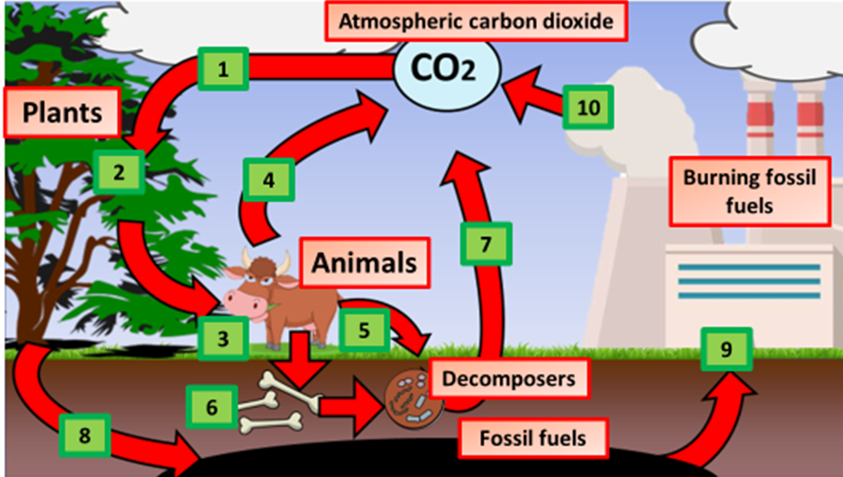

Carbon Cycle Question
The diagram below shows the carbon cycle
What is the carbon cycle?
Which gas do plants take in during photosynthesis?
How is carbon released back into the atmosphere by animals and plants?
What human activity increases carbon dioxide levels in the atmosphere?
Video Link

