Slide 1
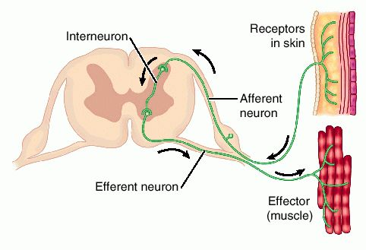

Reflexes Practice Question
The diagram below shows a reflex arc
Describe the components and events involved in a reflex arc.
________________________________________________________________________________________________________________________________________________________________________________________________________________________________________________________________________________________________________________________________________________________________________________________________________________________________________________________________________________________________________________________________________________________________________________________________________________________________________________________________________________________________________________________________________________________________________________
Answer
Link to video

