Slide 1
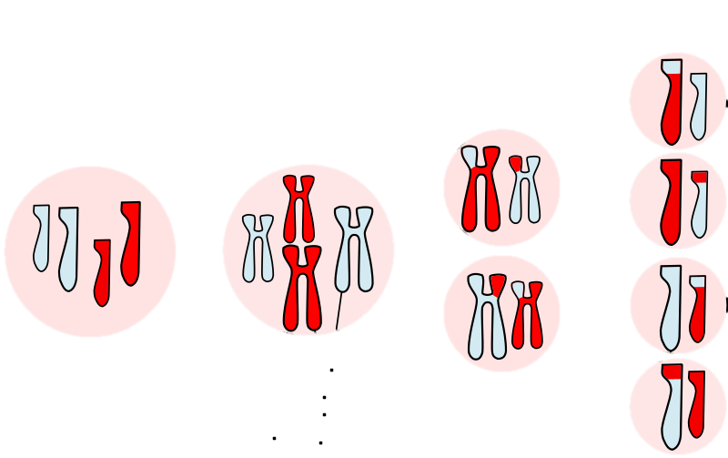

The Difference Between Mitosis & Meiosis Question
The diagram shows some of the main stages involved in meiosis. Explain four differences between mitosis and meiosis
Meiosis 2
Interphase
Meiosis 1
Homologous Chromosomes
__________________________________________________________________________________________________________________________________________________________________________________________________________________________________________________________________________________________________________________________________________________________________________________________________________________________________________________________________________________________________________________________________________________________________________________________________________________________________________________________________________________
Answer
Link to video

Slide 2

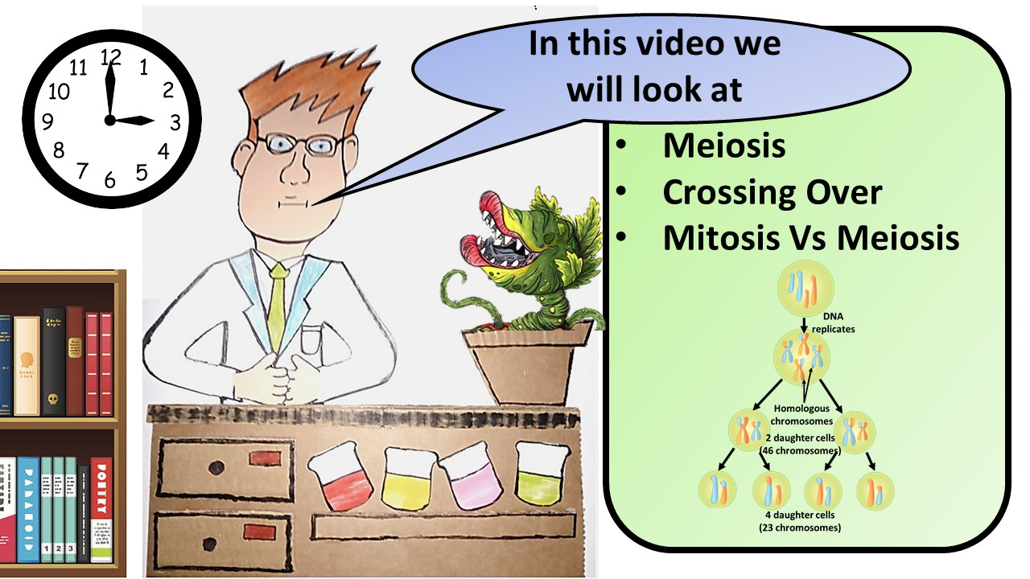


Click here to access my meiosis youtube videos
Resources that this activity would work well with
Lesson on TES
Lesson on TPT
Follow me on social media to stay in touch
Keep up to date with my new content:

