Slide 1
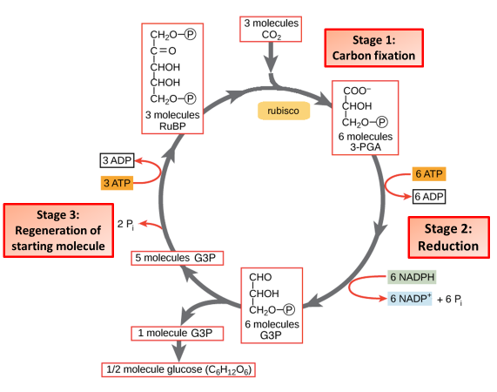
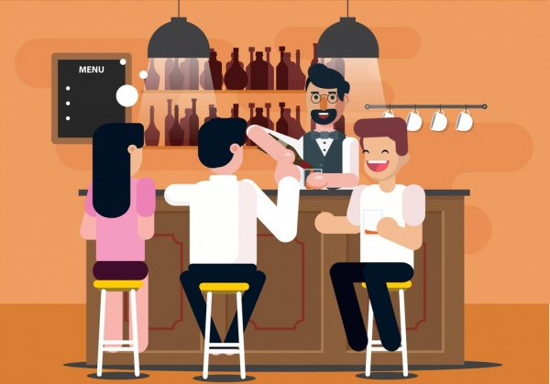
The Great Biology Pubish Quiz
Light Independent Photosynthesis

Slide 2
The Great Biology Pubish Quiz
Light Independent Photosynthesis
Where do the light-independent reactions take place?
A
Thylakoid membrane
Stroma
B
C
Cytoplasm
D
Grana

Slide 3
The Great Biology Pubish Quiz
Light Independent Photosynthesis
What is the first molecule that carbon dioxide binds to in the Calvin cycle?
A
ATP
RuBP
B
C
NADPH
D
GP

Slide 4
The Great Biology Pubish Quiz
Light Independent Photosynthesis
Which enzyme catalyses the fixation of carbon dioxide in the Calvin cycle?
A
ATP synthase
NADP reductase
B
C
RuBisCO
D
Phosphofructokinase

Slide 5
The Great Biology Pubish Quiz
Light Independent Photosynthesis
What is the first stable intermediate formed after carbon fixation?
A
Glucose
GP (glycerate-3-phosphate)
B
C
TP (triose phosphate)
D
NADPH

Slide 6
The Great Biology Pubish Quiz
Light Independent Photosynthesis
What happens to most of the TP produced in the Calvin cycle?
A
It is converted into glucose
It is used to regenerate GP
B
C
It is broken down by the mitochondria
D
It is released as oxygen

Slide 7
The Great Biology Pubish Quiz
Light Independent Photosynthesis
What is the function of the electron transport chain in the light-dependent reactions?
A
To generate oxygen
B
To produce ATP and NADPH
C
To fix carbon dioxide
D
To break down glucose

Slide 8
The Great Biology Pubish Quiz
Light Independent Photosynthesis
Question 1
B
Question 2
B
Question 3
C
Question 4
B
Question 5
A
Question 6
BA

