Slide 1
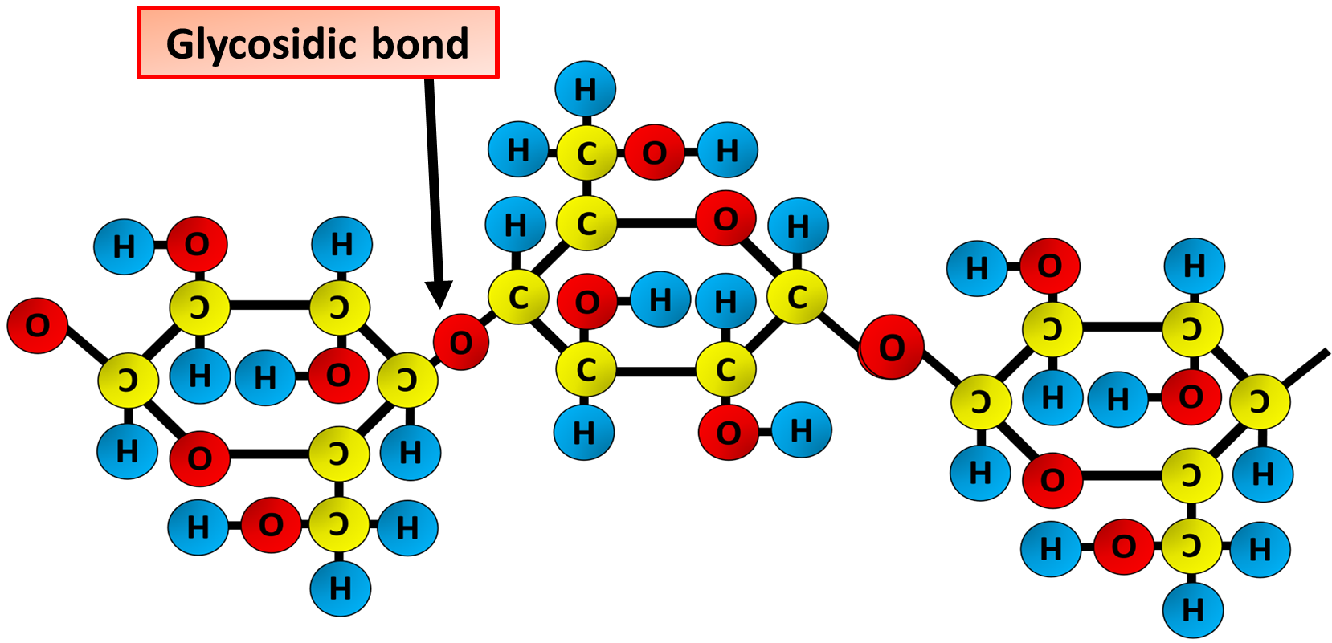

Starch Question
The diagram below shows the structure of starch. Describe the structure of starch and explain how it is suited to its function
________________________________________________________________________________________________________________________________________________________________________________________________________________________________________________________________________________________________________________________________________________________________________________________________________________________________________________________________________________________________________________________________________________________________________________________________________________________________________________________________________________________________________________________________________________________________________________
Answer
Link to video

