Slide 1
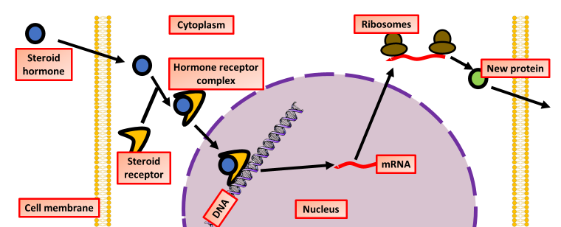

Steroid Action on Cells Question
The diagram below shows how steroid hormones act on cells
Describe the action of steroid hormones on target cells.
________________________________________________________________________________________________________________________________________________________________________________________________________________________________________________________________________________________________________________________________________________________________________________________________________________________________________________________________________________________________________________________________________________________________________________________________________________________________________________________________________________________________________________________________________________________________________________
Answer
Link to video

