Slide 1









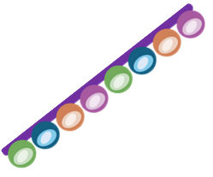
Lupus Development
Antibody-Antigen complex
Loss of immune tolerance – The immune system fails to recognise the body’s own cells as “self,” often due to a combination of genetic and environmental factors.
Tissue damage and inflammation – These immune complexes become deposited in tissues such as the skin, joints, kidneys, and blood vessels, triggering inflammation and leading to the symptoms of lupus.
Formation of immune complexes – Autoantibodies bind to self-antigens, forming antigen–antibody complexes.
Activation of immune cells – T cells and B cells become activated against these self-antigens.
Antibodies
Autoantibody production – B cells produce autoantibodies, particularly anti-nuclear antibodies (ANAs) that target DNA and other nuclear components.
Release of self-antigens – When cells are damaged or die, components such as DNA and nuclear proteins are released and mistakenly identified as foreign.
B Cell
T Cell
DNA Proteins

Slide 2
Lupus Development
Antibody-Antigen complex
Loss of immune tolerance –
Tissue damage and inflammation –
Formation of immune complexes –
Activation of immune cells –
Antibodies
Autoantibody production –
Release of self-antigens –
B Cell
T Cell
DNA Proteins

