Slide 1
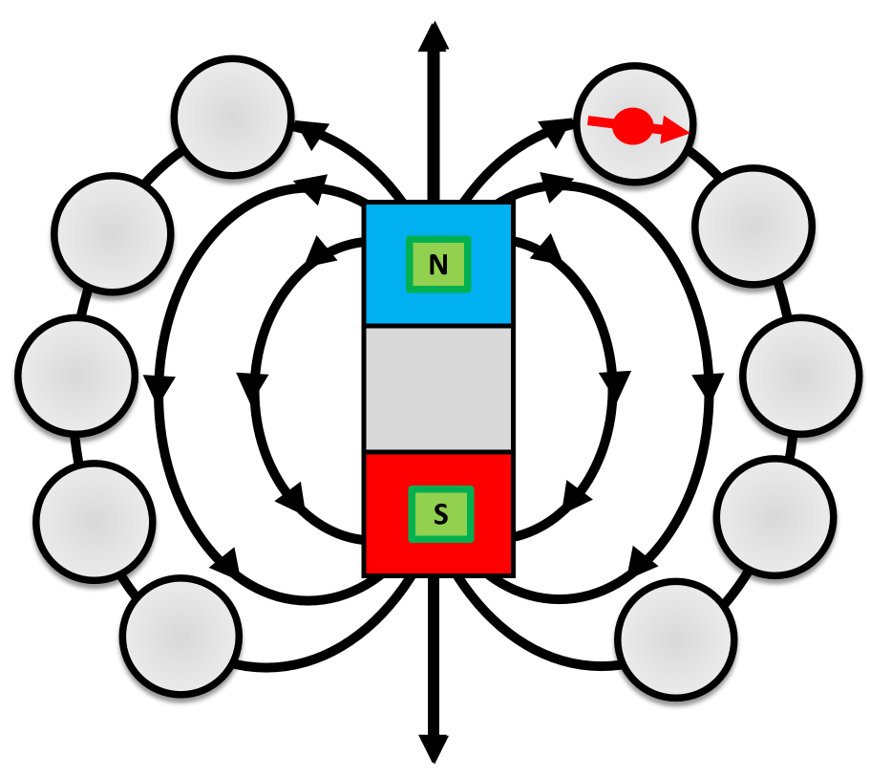

Demonstrating Magnetic Fields Question
Describe the properties of magnetic fields and how they can be demonstrated
Key things to include:
What are lines of magnetism
What direction do lines of magnetism take
How are plotting compasses used
_______________________________________________________________________________________________________________________________________________________________________________________________________________________________________________________________________________________________________________________________________________________________________________________________________________________________________
Answer
Link to video

