Slide 1
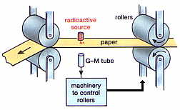
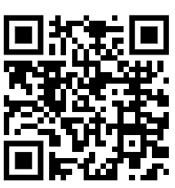
Uses of Radiation Practice Question
Using the diagram below describe in detail how radiation can be used to measure and control the thickness of paper
Key things to include:
What sort of radiation is used and why
How will the paper thickness affect the amount of radiation getting through
_____________________________________________________________________________________________________________________________________________________________________________________________________________________________________________________________________________________________________________________________________________________________________________________________________________________________________________________________________________________________________________________________________
Answer
Link to video

Slide 2
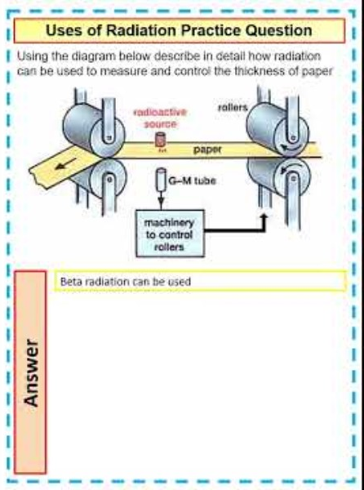
Uses of Radiation Practice Question

