Slide 1
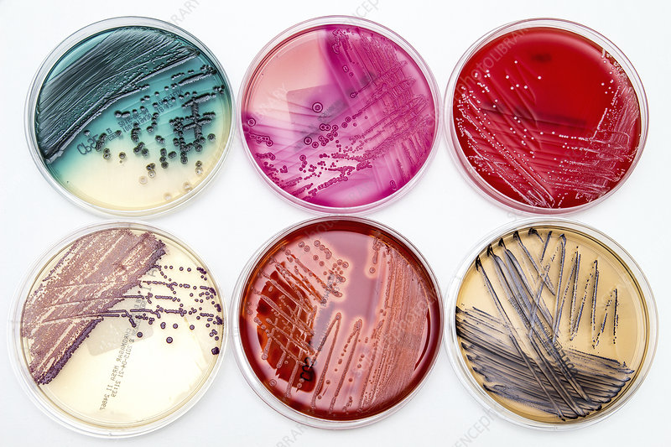

Factors Affecting Bacterial Growth Question
Explain the factors that influence bacterial growth in a culture and how these factors affect the rate of reproduction.
____________________________________________________________________________________________________________________________________________________________________________________________________________________________________________________________________________________________________________________________________________________________________________________________________________________________________________________________________________________________________________________________________________________________________________________
Answer
Link to video

