Slide 1
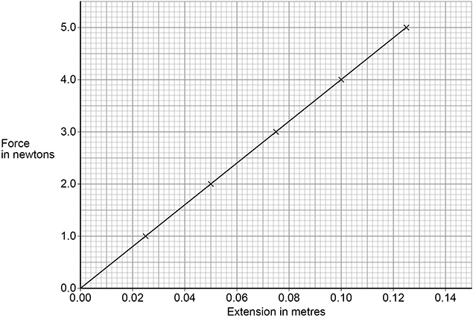

Stretching a Spring Practice Question
A student investigated the relationship between the force applied to a spring and the extension of the spring.
Describe a method the student could use to obtain the results given in Figure 2.
Key things to include:
Dependent variables
Independent variables
Control variables
_______________________________________________________________________________________________________________________________________________________________________________________________________________________________________________________________________________________________________________________________________________________________________________________________________________________________________
Answer
Link to video

Slide 2
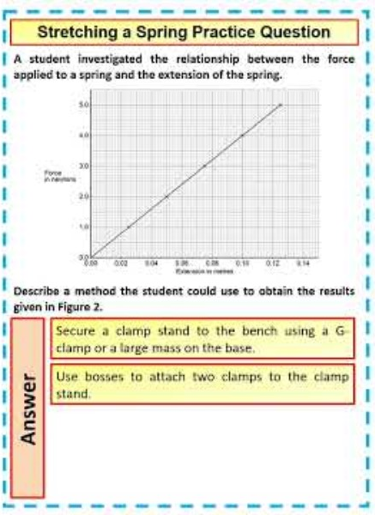
Stretching a Spring Practice Question

