Slide 1
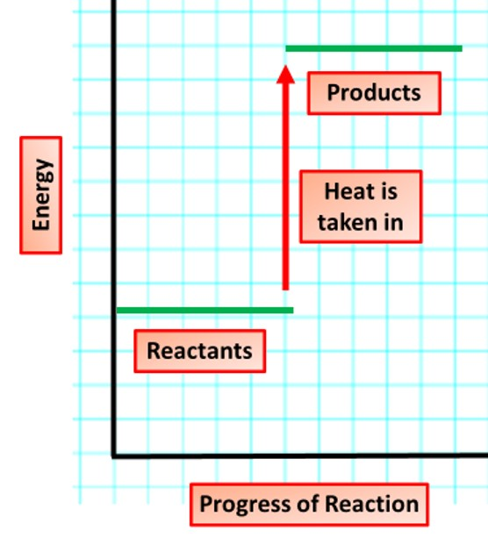
Endothermic Reaction Question
The diagram shows the energy changes in an endothermic reaction
Video link
What happens to heat energy in an endothermic reaction?
Does the temperature of the surroundings increase or decrease in an endothermic reaction?
Give an example of an endothermic reaction.
Is the energy of the products higher or lower than that of the reactants in an endothermic reaction?

