Slide 1
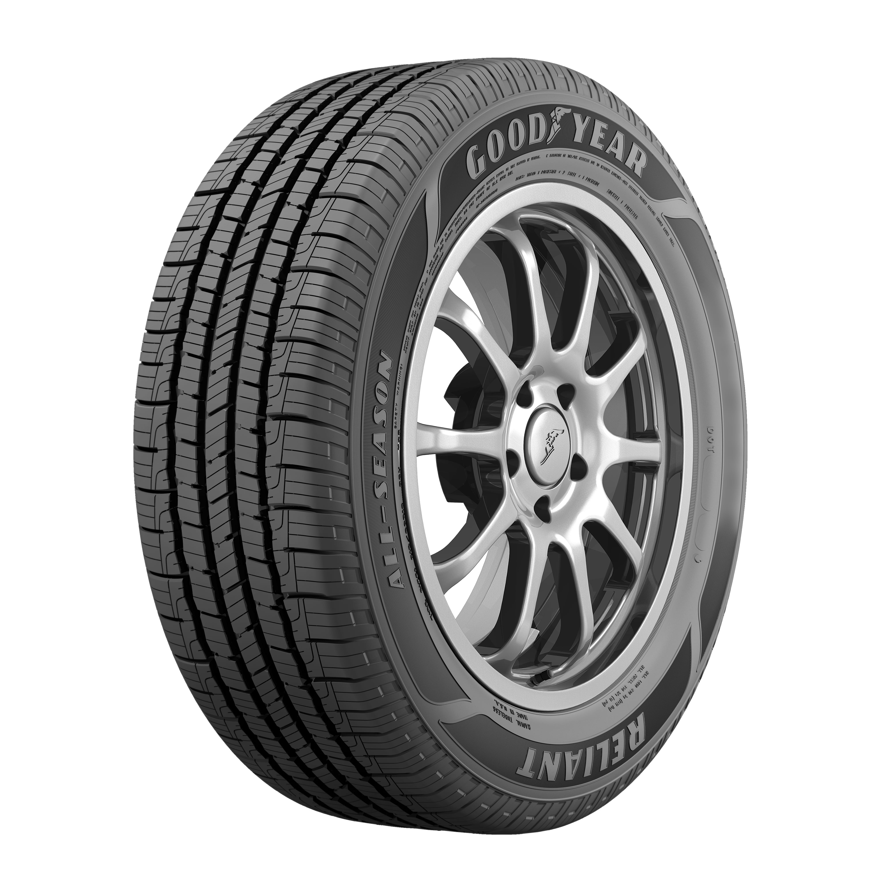

Air Pressure Practice Question
The air pressure in a car tyre changes if the temperature of the air in the tyre increases.
Explain why.
Key things to include:
What happens to gas particles as the heat up
How do gas particles cause pressure in a container
Answer
_________________________________________________________________________________________________________________________________________________________________________________________________________________________________________________________________________________________________________________________________________
Link to video

Slide 2
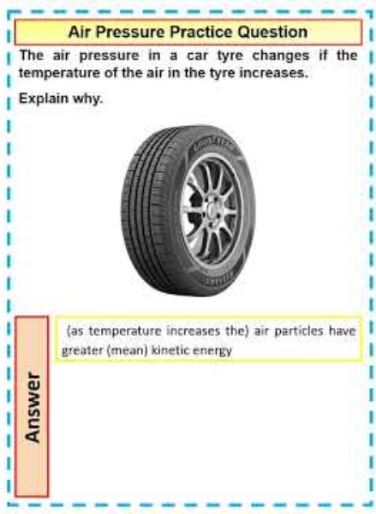
Air Pressure Practice Question

