Slide 1
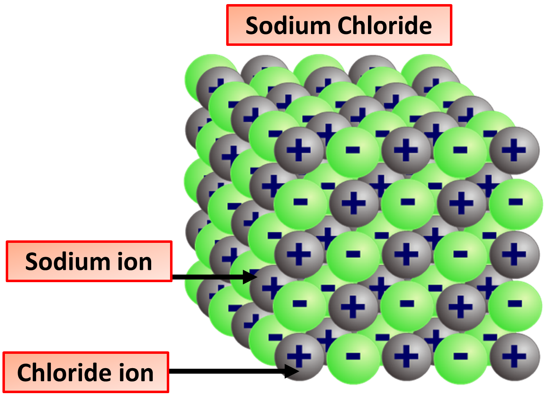
Giant Ionic Compounds Practice Question
Sodium Chloride is an example of a giant ionic compound. Explain why giant ionic compounds, like sodium chloride, have high melting and boiling points.
Key things to include:
What holds the atoms together
What shape / form do the ions take
How much energy is needed to break the bonds
What effect does that have on the amount of heat needed to break the bonds
_____________________________________________________________________________________________________________________________________________________________________________________________________________________________________________________________________________________________________________________________________________________________________________________________________________________________________________________________________________________________________________________________________
Answer
Link to video

Slide 2
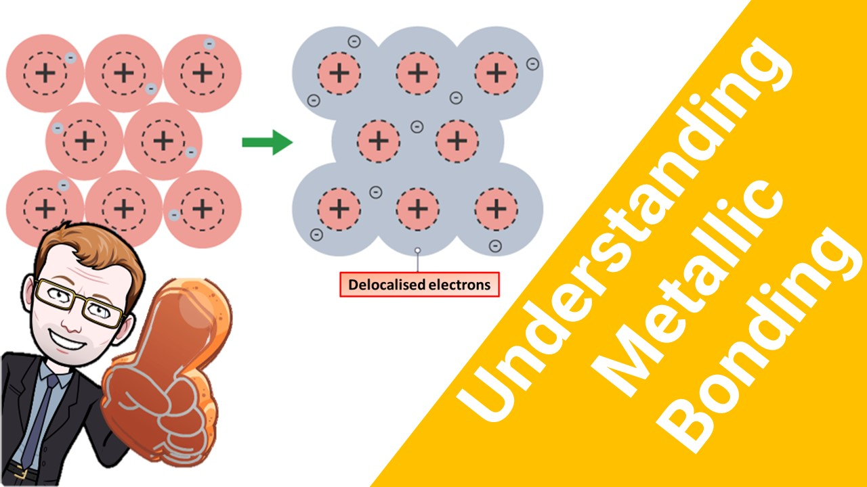
Click here to access my bonding youtube videos
Resources that this activity would work well with
Lesson on TES
Lessons on TPT
Follow me on social media to stay in touch
Keep up to date with my new content:

