Slide 1
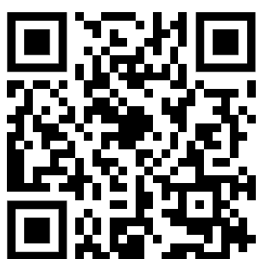
Animal Cells Question
The diagram shows an animal cell:
What is the part of an animal cell that controls the activities of the cell?
What jelly-like substance fills the inside of an animal cell and is where chemical reactions happen?
What part of an animal cell surrounds the cell and controls what goes in and out?
What part of an animal cell is responsible for producing energy?
Mark Scheme

