Slide 1
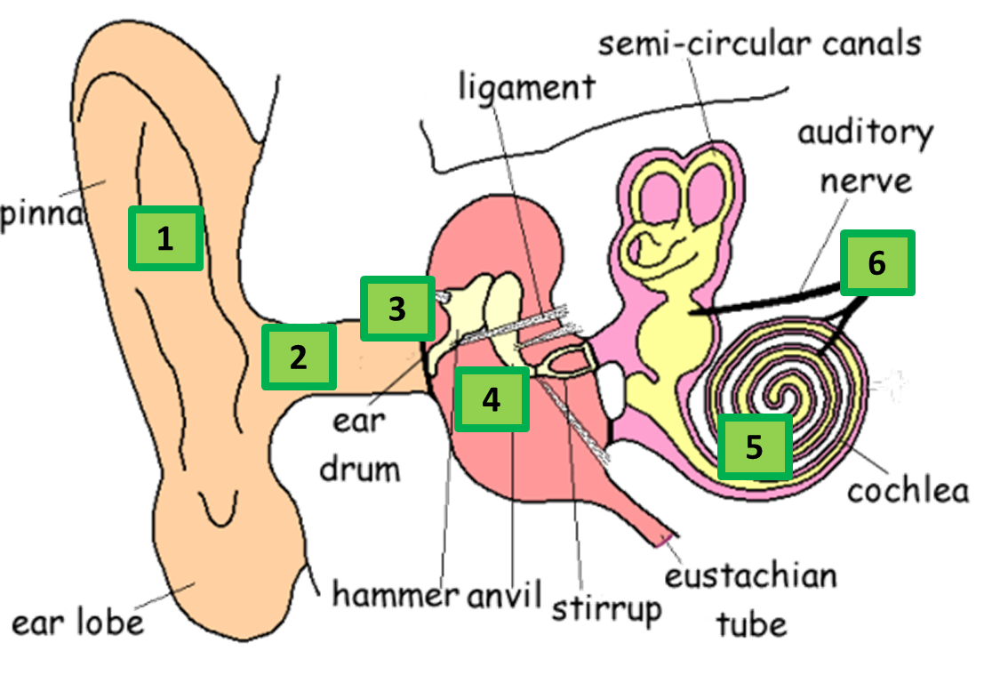

The Ear Question
Describe how the ear detects sound and converts it into electrical signals.
Key things to include:
What the role of the ear drum is
What the role of the bones are
What the role of the cochlea is
_______________________________________________________________________________________________________________________________________________________________________________________________________________________________________________________________________________________________________________________________________________________________________________________________________________________________________
Answer
Link to video

