Slide 1
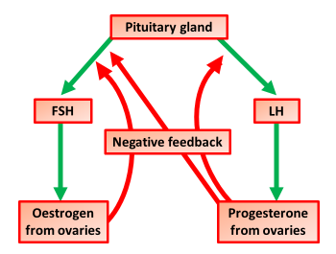

Reproductive Hormones Question
The diagram below shows how hormones are involved in the reproductive cycle
Video Link
Which hormone is responsible for triggering ovulation in females?
What hormone maintains the uterine lining during pregnancy?
Which hormone stimulates egg production in females?
What is the role of oestrogen in the menstrual cycle?

