Slide 1
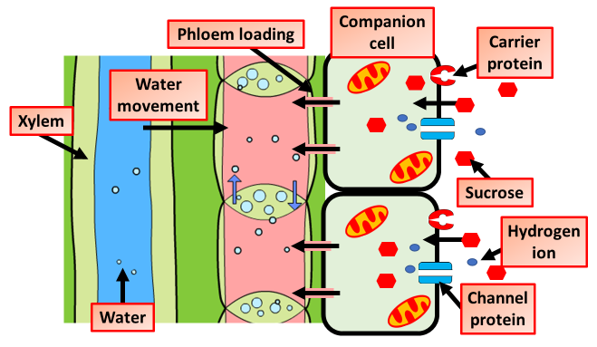

Phloem Loading Question
The diagram below shows vascular tissue in plants. Explain how sucrose is loaded into the phloem.
____________________________________________________________________________________________________________________________________________________________________________________________________________________________________________________________________________________________________________________________________________________________________________________________________________________________________________________________________________________________________________________________________________________________________________________
Answer
Video link

