Slide 1
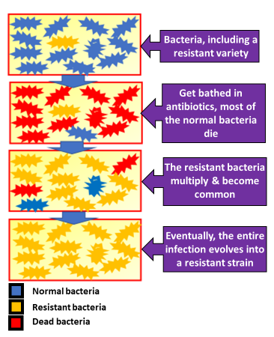

Antibiotic Resistant Bacteria Question
Penicillin is an antibiotic which stops bacteria from reproducing. It was used a lot in the past to treat bacterial infections in humans and other animals. In many hospitals there are now strains of penicillin resistant bacteria.
Explain how natural selection could have produced these strains of penicillin resistant bacteria.
Key things to include:
What effect do antibiotics have on bacteria
What do we call a change in the DNA
Why do some bacteria survive
What can the surviving bacteria do
______________________________________________________________________________________________________________________________________________________________________________________________________________________________________________________________________________________________________________________________________________________________________________________________________________________________________________________________________________________
Answer
Link to video

Slide 2
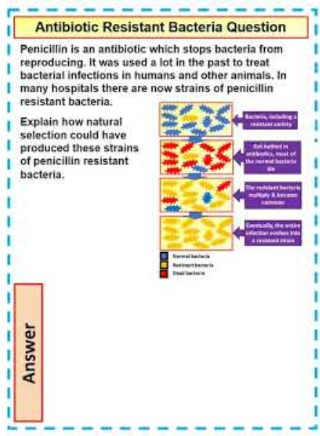
Antibiotic Resistant Bacteria Question

Slide 3

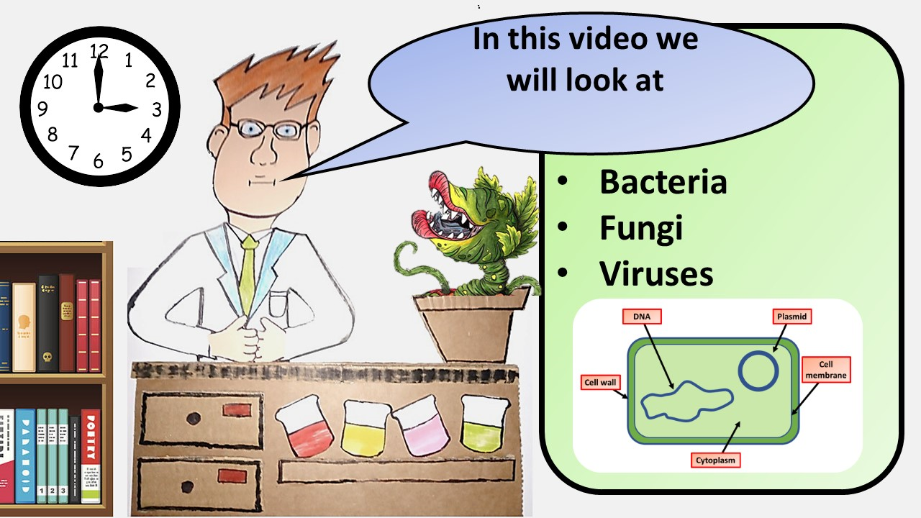


Click here to access my Pathogens youtube videos
Resources that this activity would work well with
Lesson on TES
Lesson on TPT
Follow me on social media to stay in touch
Keep up to date with my new content:

