Slide 1
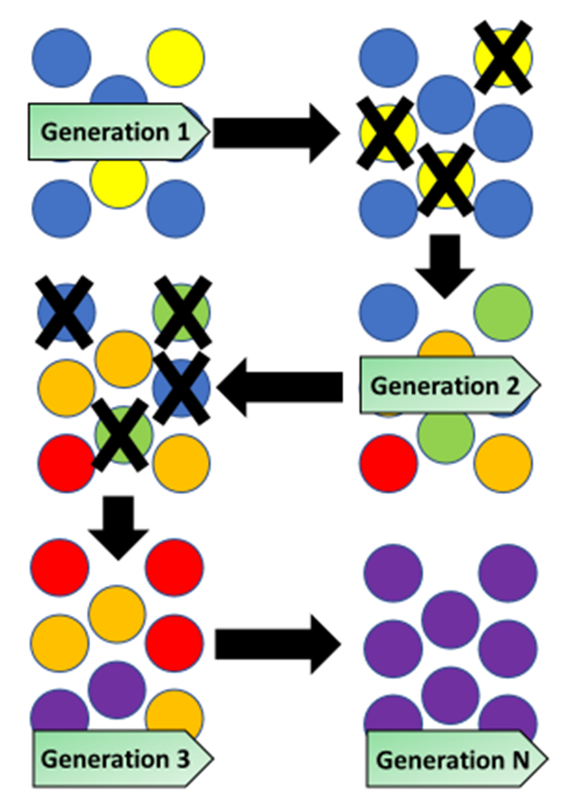

Evolution Question
The diagram below shows how evolution takes place
Video Link
What is evolution?
Who proposed the theory of natural selection?
What do we call traits that help an organism survive in its environment?
What is the process where better-adapted organisms survive and reproduce?

