Slide 1


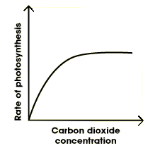
The Great Biology Pubish Quiz
Limiting Factors

Slide 2

The Great Biology Pubish Quiz
Limiting Factors
Which factor is most likely to limit photosynthesis at night?
A
Temperature
Carbon dioxide
B
C
Light intensity
D
Water availability

Slide 3
The Great Biology Pubish Quiz
Limiting Factors
Which limiting factor is most affected by stomatal closure?
A
Oxygen
Carbon dioxide
B
C
Light
D
Temperature

Slide 4
The Great Biology Pubish Quiz
Limiting Factors
What term describes the point at which increasing light no longer increases the rate of photosynthesis?
A
Light plateau
Saturation point
B
C
Compensation point
D
Limiting factor

Slide 5
The Great Biology Pubish Quiz
Limiting Factors
Which of the following is a direct input to the light-independent reactions of photosynthesis?
A
Light
Water
B
C
NADPH
D
Oxygen

Slide 6
The Great Biology Pubish Quiz
Limiting Factors
How does high temperature affect the rate of photosynthesis beyond the optimum?
A
Increases steadily
Plateaus
B
C
Decreases due to enzyme denaturation
D
Remains constant

Slide 7
The Great Biology Pubish Quiz
Limiting Factors
Which condition is not commonly a limiting factor in photosynthesis in natural outdoor environments?
A
Light intensity
B
Carbon dioxide concentration
C
Chlorophyll concentration
D
Temperature

Slide 8

The Great Biology Pubish Quiz
Limiting Factors
Question 1
C
Question 2
B
Question 3
B
Question 4
C
Question 5
C
Question 6
C

