Slide 1
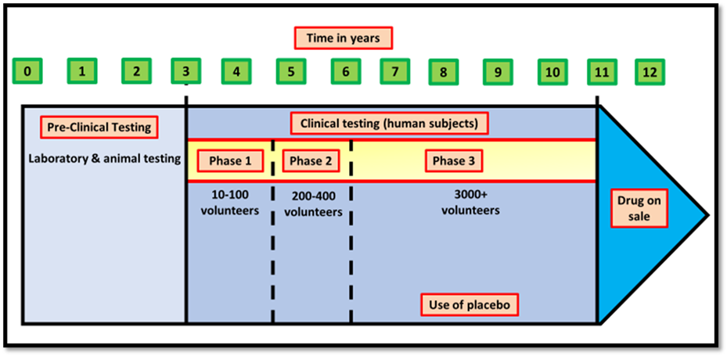
Drug Development Question
The diagram shows some of the stages of drug development
What is the first stage of drug development called?
What is the process of testing a new drug in human volunteers known as?
What term describes modifying a drug to improve its properties?
What must a new drug obtain from regulatory authorities before it can be marketed?

