Slide 1
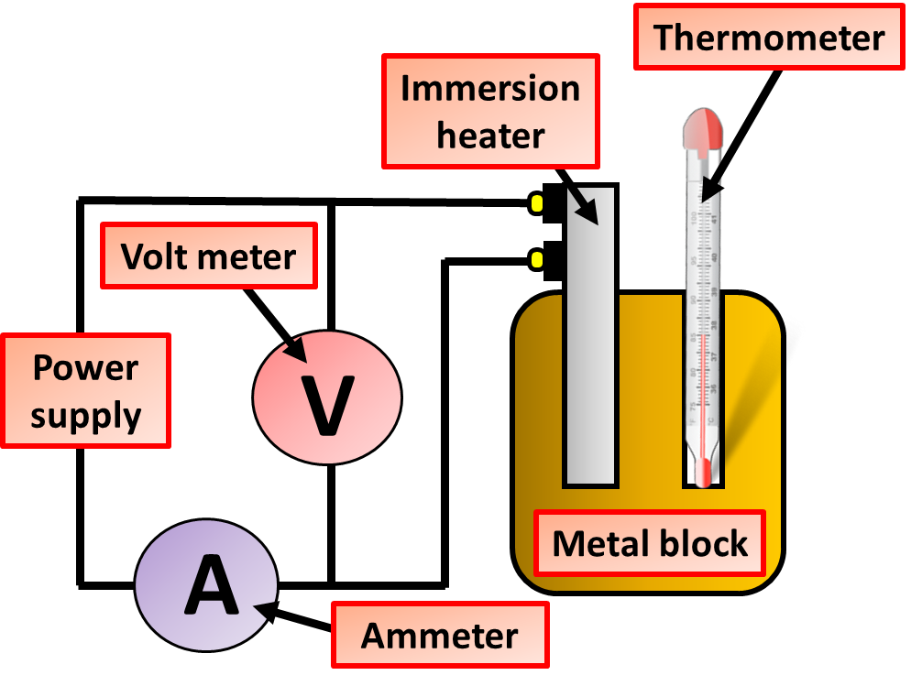

SHC Investigation Question
Describe how you would carry out an experiment to determine the specific heat capacity (SHC) of 1 kg of copper.
Key things to include:
How is it set up
What readings do you take
How would you calculate SHC
_______________________________________________________________________________________________________________________________________________________________________________________________________________________________________________________________________________________________________________________________________________________________________________________________________________________________________
Answer
Link to video

