Slide 1
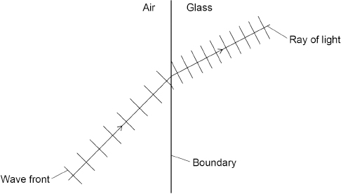
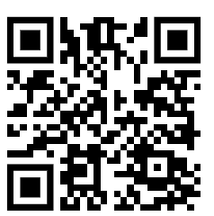
Refraction Practice Question
Figure 4 shows what happens to wave fronts as they pass across the boundary between air and glass.
Explain in terms of the wave fronts, why refraction happens at the boundary between air and glass.
Key things to include:
How does the wave front enter the glass
What happens to speed of the wave as it moves through the glass
Answer
_____________________________________________________________________________________________________________________________________________________________________________________________________________________________________________________________________________________________________________________________________
Link to video

Slide 2
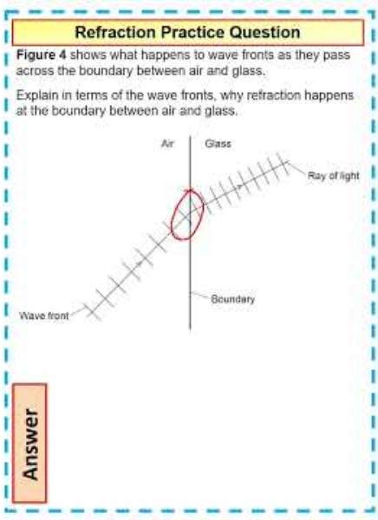
Refraction Practice Question

