Slide 1


Radioactive Contamination Practice Question
Internal contamination of the human body means radioactive material is inside the human body.
Explain how the risk from internal contamination is different to the risk from external irradiation by a source of alpha radiation.
Key things to include:
How penetrating alpha radiation is
Why alpha radiation can’t get out of the body
How alpha radiation damages the body
Answer
_________________________________________________________________________________________________________________________________________________________________________________________________________________________________________________________________________________________________________________________________________
Link to video

Slide 2
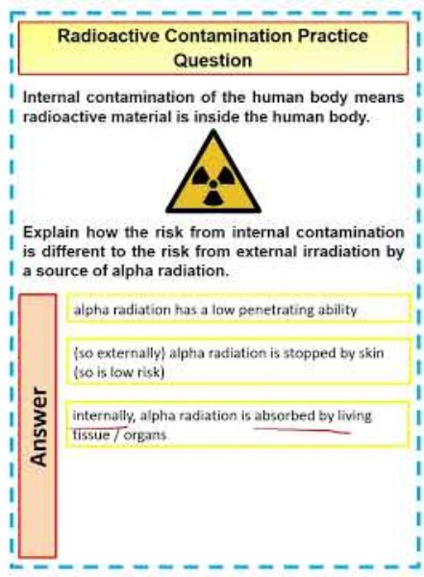
Radioactive Contamination Practice Question

