Slide 1
Covalent Bonding in Water Question
Water, H2O, has covalent bonds.
Describe how covalent bonds are formed, draw a dot and cross diagram to show the bonding in water and explain the bonding in water.
Key things to include:
What sort of bonding do we have in water
How are these bonds formed
What do atoms want in their outer shells
_____________________________________________________________________________________________________________________________________________________________________________________________________________________________________________________________________________________________________________________________________________________________________________________________________________________________________________________________________________________________________________________________________
Answer
Link to video

Slide 2
Covalent Bonding in Water Question

Slide 3
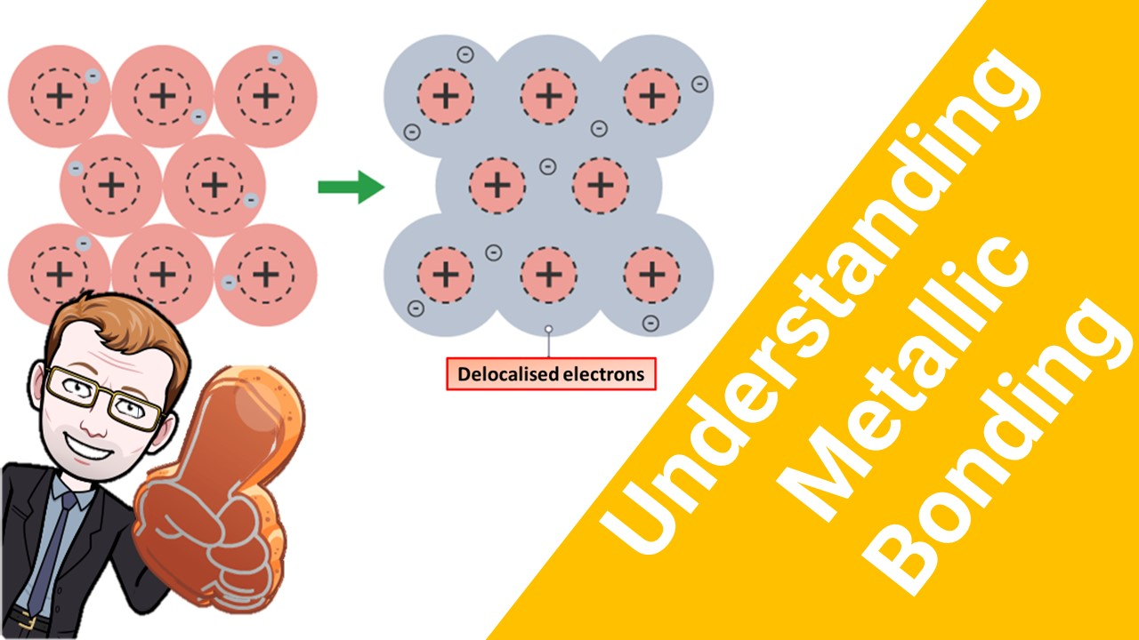
Click here to access my bonding youtube videos
Resources that this activity would work well with
Lesson on TES
Lessons on TPT
Follow me on social media to stay in touch
Keep up to date with my new content:

