Slide 1
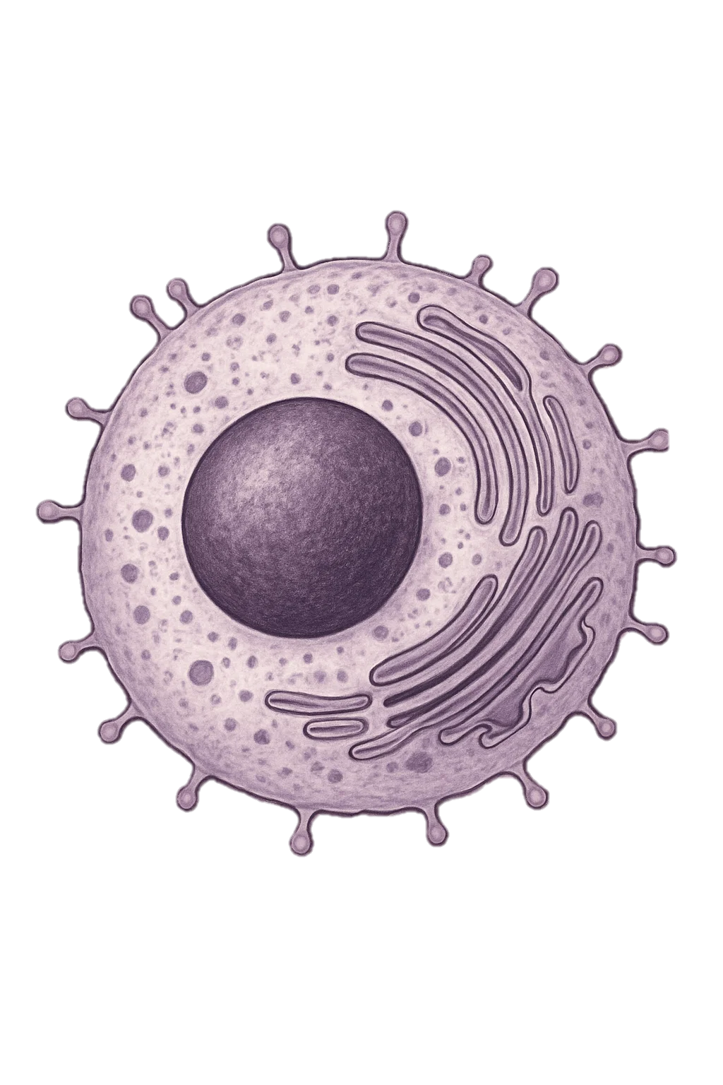

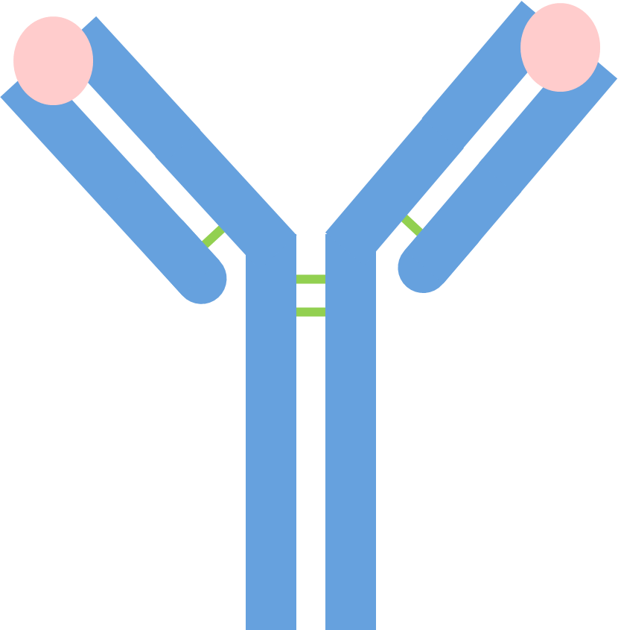
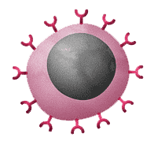
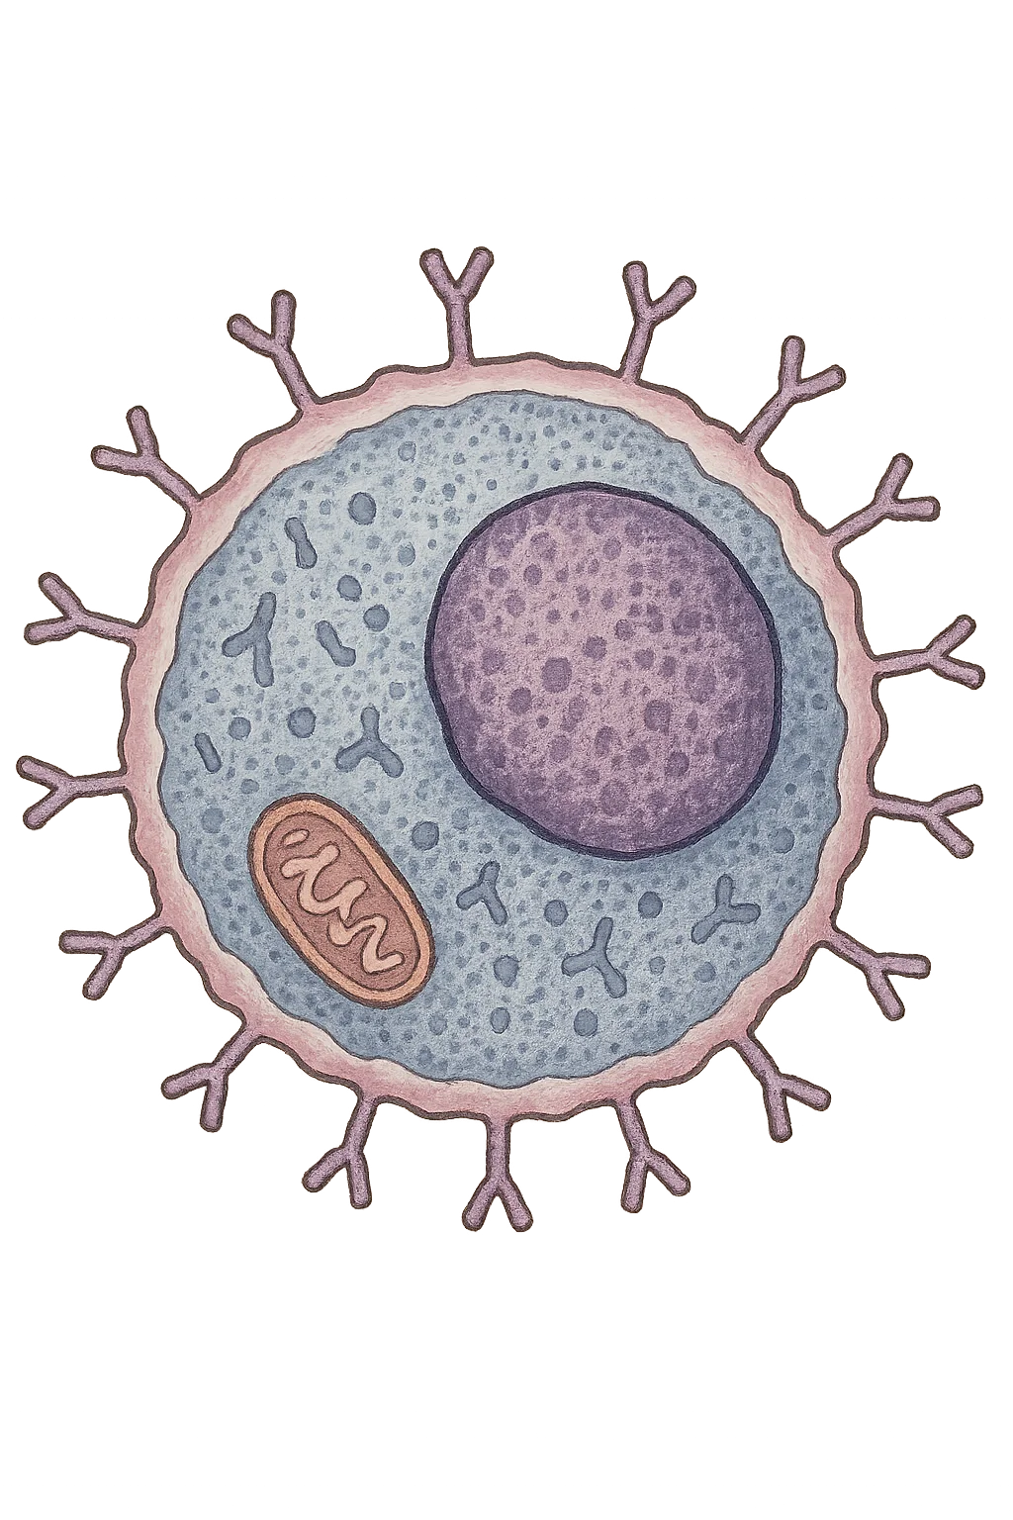
1: Pathogen enters the body – A harmful microorganism, such as a virus or bacterium, gets into the body and is recognised as foreign because of the antigens on its surface.
Antibody Production
5: Antibodies destroy the pathogen – The antibodies bind to the pathogens, helping to neutralise them or mark them so other white blood cells can destroy them. Memory cells may also remain to give long-term immunity.
3: Lymphocytes are activated – The lymphocyte becomes active and starts to divide rapidly, making many identical copies of itself.
B lymphocyte
Plasma B Cells
Pathogen
Antibodies
Memory B Cells
2: White blood cells detect the antigen – A type of white blood cell called a lymphocyte recognises the antigen as something that does not belong in the body.
4: Antibodies are produced – These cloned lymphocytes begin to make and release antibodies, which are special proteins designed to match and attach to the specific antigen.

Slide 2
1: Pathogen enters the body –
Antibody Production
5: Antibodies destroy the pathogen –
3: Lymphocytes are activated –
B lymphocyte
Plasma B Cells
Pathogen
Antibodies
Memory B Cells
2: White blood cells detect the antigen –
4: Antibodies are produced –

