Slide 1
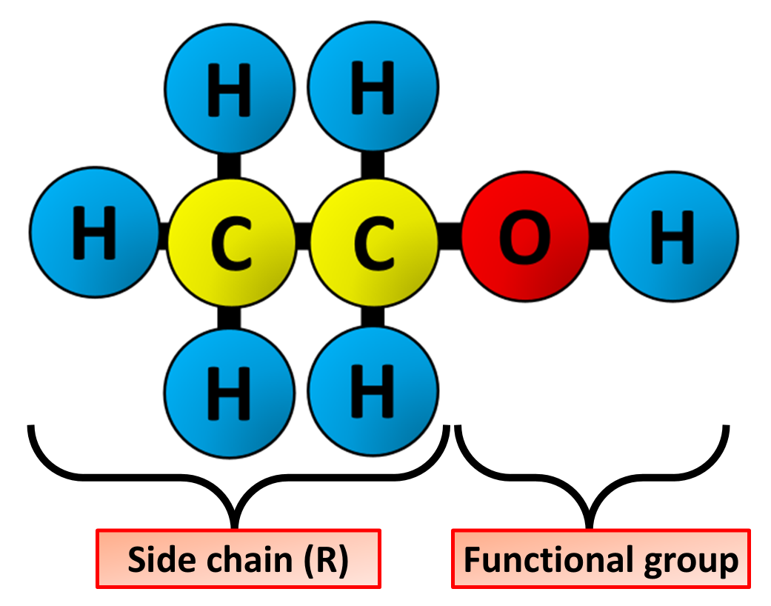

Alcohol Structure Question
The diagram shows the structure of ethanol. Describe the structure of alcohols and explain how they differ from alkanes.
Key things to include:
What is the functional group
What are the properties of alcohols
_______________________________________________________________________________________________________________________________________________________________________________________________________________________________________________________________________________________________________________________________________________________________________________________________________________________________________
Answer
Link to video

