Slide 1
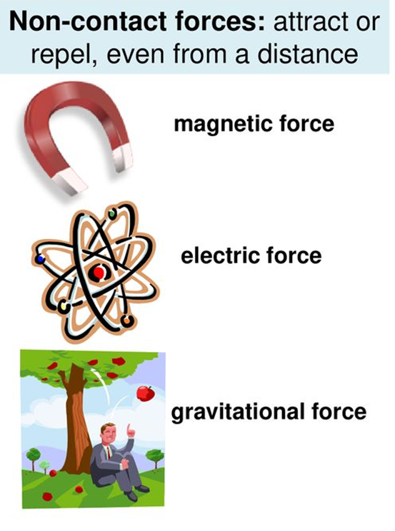
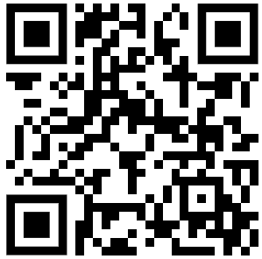
Non-Contact Forces Question
Below are some examples of noncontact forces
Mark Scheme
What is a non-contact force?
Give one example of a non-contact force.
Which non-contact force causes a magnet to attract a paperclip?
Which non-contact force causes a balloon to stick to a wall after being rubbed?

