Slide 1

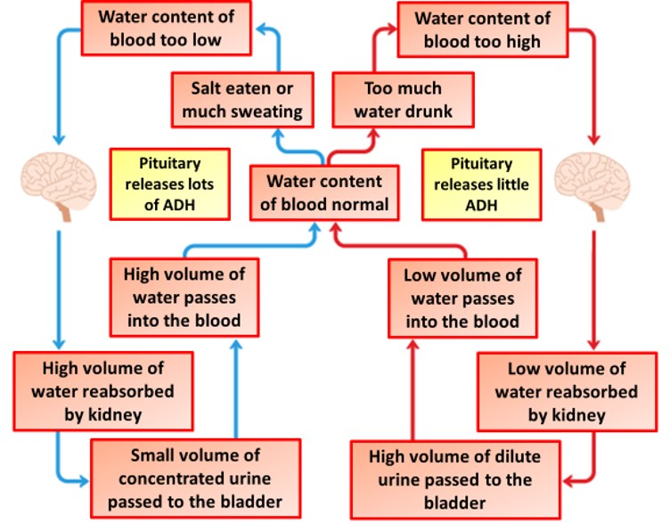

The Great Biology Pubish Quiz
Osmoregulation

Slide 2
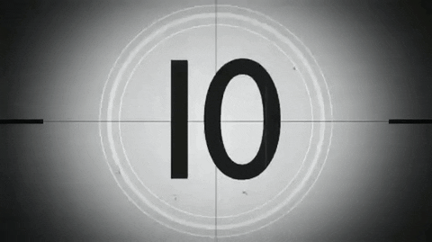
The Great Biology Pubish Quiz
Osmoregulation
Which hormone controls water reabsorption in the kidneys?
A
Insulin
Glucagon
B
C
ADH
D
Renin

Slide 3
The Great Biology Pubish Quiz
Osmoregulation
Where is ADH produced?
A
Liver
B
Kidney
C
Pituitary
D
Pancreas

Slide 4
The Great Biology Pubish Quiz
Osmoregulation
Which part of the nephron does ADH mainly affect?
A
Capsule
Loop
B
C
Tubule
D
Collecting duct

Slide 5
The Great Biology Pubish Quiz
Osmoregulation
Osmoregulation maintains the balance of which substance in the blood?
A
Water
Oxygen
B
C
Protein
D
Glucose

Slide 6
The Great Biology Pubish Quiz
Osmoregulation
Which receptors detect blood water potential?
A
Baroreceptors
Osmoreceptors
B
C
Thermoreceptors
D
Photoreceptors

Slide 7
The Great Biology Pubish Quiz
Osmoregulation
Where are osmoreceptors located?
A
Kidney
B
Liver
C
Cortex
D
Hypothalamus

Slide 8

The Great Biology Pubish Quiz
Osmoregulation
Question 1
C
Question 2
C
Question 3
D
Question 4
A
Question 5
B
Question 6
D

