Slide 1

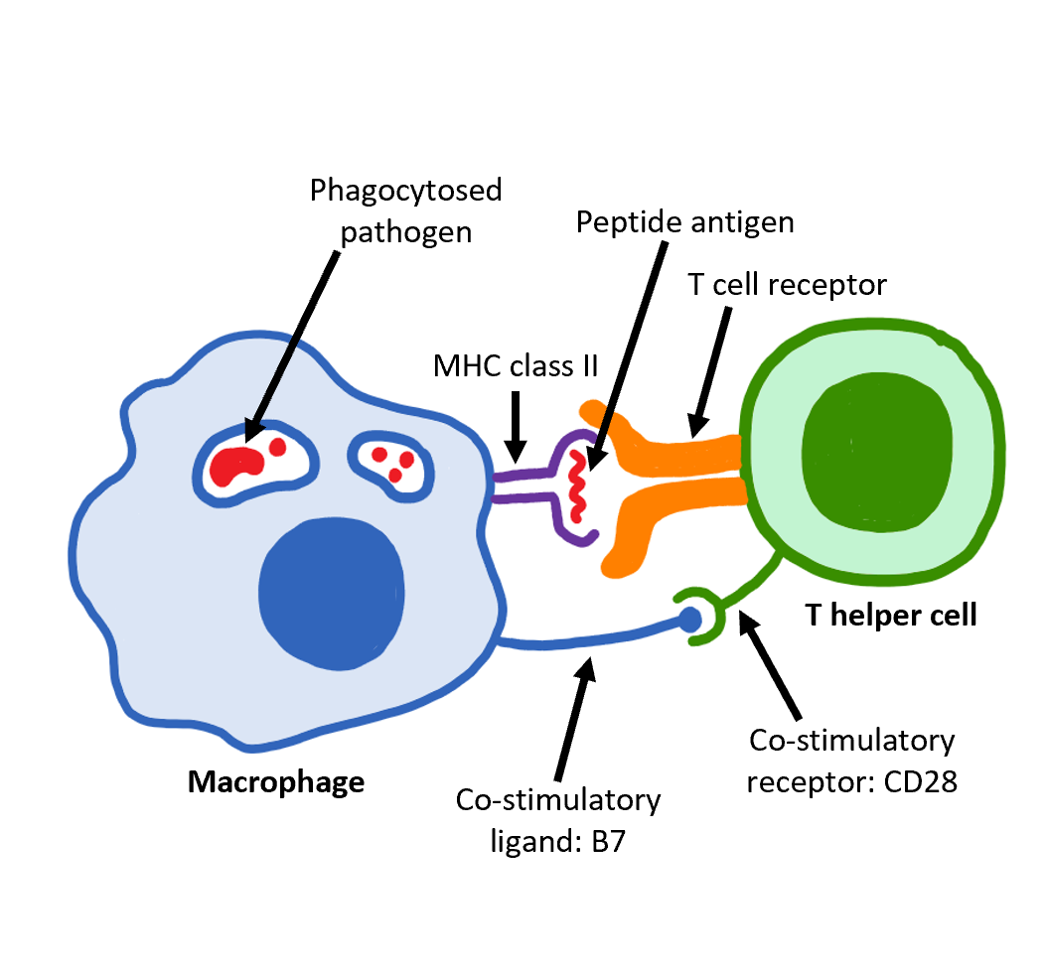

The Great Biology Pubish Quiz
The Interaction Between T & B cells

Slide 2

The Great Biology Pubish Quiz
The Interaction Between T & B cells
What type of T cell activates B cells?
A
Binding to an antigen-presenting cell
Binding to a plasma cell
B
C
Detecting antibodies
D
Contact with a pathogen

Slide 3
The Great Biology Pubish Quiz
The Role of T Cells
The Great Biology Pubish Quiz
The Interaction Between T & B cells
What do activated T helper cells release to stimulate B cells?
A
Antibodies
Histamines
B
C
Perforin
D
Cytokines

Slide 4
The Great Biology Pubish Quiz
The Role of T Cells
The Great Biology Pubish Quiz
The Interaction Between T & B cells
What is the role of cytokines released by T helper cells?
A
Destroy infected cells
Stimulate B cell activation and division
B
C
Digest pathogens
D
Transport antigens

Slide 5
The Great Biology Pubish Quiz
The Role of T Cells
The Great Biology Pubish Quiz
The Interaction Between T & B cells
What happens when B cells are activated by T helper cells?
A
They engulf pathogens
They mutate their receptors
B
C
They produce and secrete antigens
D
They divide into plasma and memory cells

Slide 6
The Great Biology Pubish Quiz
The Role of T Cells
The Great Biology Pubish Quiz
The Interaction Between T & B cells
What is the main role of helper T cells?
A
Antibodies
B
Antigens
C
Toxins
D
Cytokines

Slide 7
The Great Biology Pubish Quiz
The Role of T Cells
The Great Biology Pubish Quiz
The Interaction Between T & B cells
What type of immune response involves the interaction between T helper cells and B cells?
A
Innate immune response
Passive immunity
B
C
Humoral immune response
D
Physical barrier defence

Slide 8

The Great Biology Pubish Quiz
The Role of T Cells
The Great Biology Pubish Quiz
The Interaction Between T & B cells
Question 1
A
Question 2
D
Question 3
B
Question 4
D
Question 5
A
Question 6
C

