Slide 1
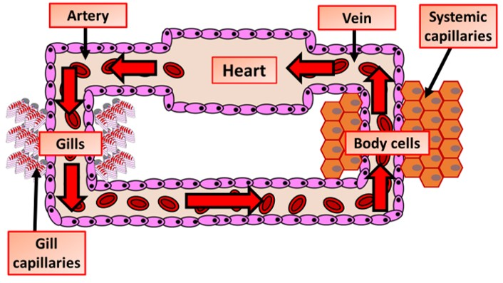

Single Closed Circulation Question
The diagram below shows single closed circulation
Describe the main features of a single closed circulatory system.
________________________________________________________________________________________________________________________________________________________________________________________________________________________________________________________________________________________________________________________________________________________________________________________________________________________________________________________________________________________________________________________________________________________________________________________________________________________________________________________________________________________________________________________________________________________________________________
Answer
Link to video

