Slide 1


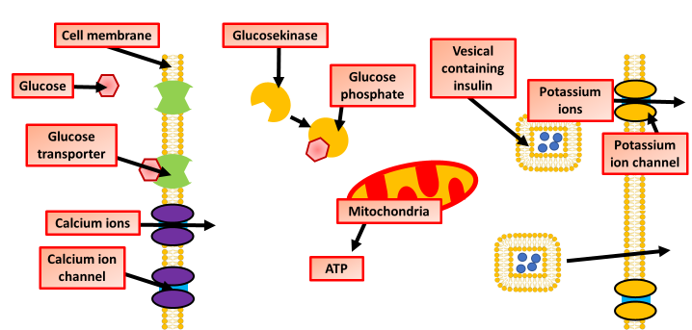
The Great Biology Pubish Quiz
The Release of Insulin

Slide 2

The Great Biology Pubish Quiz
The Release of Insulin
What triggers the release of insulin from the beta cells in the pancreas?
A
High blood glucose levels
Low blood glucose levels
B
C
High lipid levels
D
Low oxygen levels

Slide 3
The Great Biology Pubish Quiz
The Release of Insulin
Which ion plays a key role in insulin release from beta cells?
A
Sodium (Na⁺)
Calcium (Ca²⁺)
B
C
Potassium (K⁺)
D
Chloride (Cl⁻)

Slide 4
The Great Biology Pubish Quiz
The Release of Insulin
What is the role of ATP in the process of insulin release?
A
It opens calcium channels directly
It stimulates glucagon production
B
C
It breaks down glucose in the bloodstream
D
It closes potassium channels

Slide 5
The Great Biology Pubish Quiz
The Release of Insulin
What happens when the potassium channels in beta cells close?
A
The cell becomes hyperpolarized
Glucagon release is triggered
B
C
The cell becomes depolarized
D
Insulin release is triggered

Slide 6
The Great Biology Pubish Quiz
The Release of Insulin
What occurs after calcium ions enter the beta cells?
A
Insulin is stored in vesicles
Insulin vesicles fuse with the cell membrane and release insulin
B
C
Insulin production increases
D
Glucagon is secreted

Slide 7
The Great Biology Pubish Quiz
The Release of Insulin
Which of the following hormones inhibits insulin release?
A
Glucagon
Adrenaline
B
C
Somatostatin
D
Thyroxine

Slide 8

The Great Biology Pubish Quiz
Structure of the Pancreas
Question 1
A
Question 2
B
Question 3
D
Question 4
C
Question 5
B
Question 6
C

