Slide 1
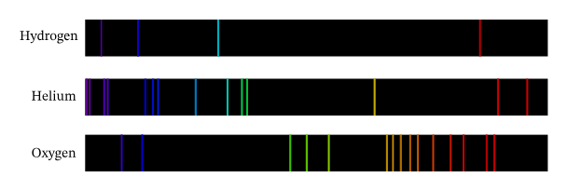

Emission Spectra Question
Describe how emission spectra are produced and how they are used to identify elements.
Key things to include:
Why do atoms give off light
What do emission spectra show
Where are emission spectra useful
_______________________________________________________________________________________________________________________________________________________________________________________________________________________________________________________________________________________________________________________________________________________________________________________________________________________________________
Answer
Link to video

