Slide 1
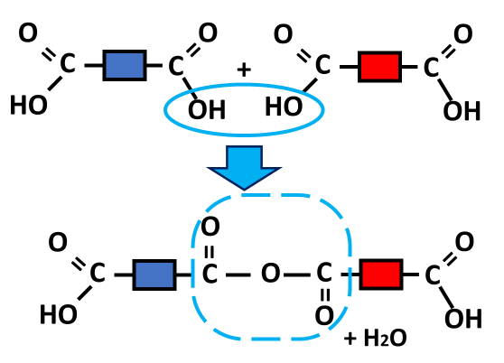

Condensation Polymerisation Question
The diagram shows how condensation polymerisation takes place. Describe the process of condensation polymerisation and explain how it differs from addition polymerisation.
Key things to include:
What groups react
What molecule is removed
_______________________________________________________________________________________________________________________________________________________________________________________________________________________________________________________________________________________________________________________________________________________________________________________________________________________________________
Answer
Link to video

